Slide 1
Watson Speech to Text Demo Application
Mar. 16, 2017
Cloud&Cognitive, IBM Japan
Kohzo Momose(kmomose@jp.ibm.com)

Slide 2
Preface
This application provides sample codes for Watson Speech to Text by using Node-Red on Bluemix.
The source codes are available on GIT.
GITHub: https://github.com/kmomose/watson
NodeRed Library: https://flows.nodered.org/flow/d43d0733b42ee0d42e7bba896d20d09b

Slide 3
Contents
Architecture
Demo Environment
HTTP API Demo Application
websocket API Demo Application
Corpora & Words Management
Call center Demo Application
Findings

Slide 4











Architecture
PUBLIC NETWORK
CLOUD NETWORK
ENTERPRISE NETWORK
NODE-RED
WATSON
FREEDASHBORD
Observer’s Dashboard
・View Transcripts
・View Words (OOV: Out of Vocabulary)
WATSON
SPEECH TO TEXT
Voice Record
SECURITY
NODE.JS RUNTIME
CLOUDANT
NOSQL DB
Corpora
Words
QA Responder
Subject Matter Expert
USER
TWILIO
Cloud Phone
CALL CENTER
Automatic Responder System

Slide 5
Demo Environment：Bluemix PaaS
PUBLIC NETWORK
CLOUD NETWORK
ENTERPRISE NETWORK
GITHUB
Object Storage
Local Storage
etc
Bluemix@Sydney
NODE-RED
WATSON
FREEDASHBORD
Observer’s Dashboard
・View Transcripts
・View Words (OOV: Out of Vocabulary)
WATSON
SPEECH TO TEXT
Voice Record
SECURITY
NODE.JS RUNTIME
CLOUDANT
NOSQL DB
コーパス
辞書
TWILIO
Bluemix@Dallas
QA Responder
Subject Matter Expert
USER
TWILIO
Cloud Phone
CALL CENTER
Automatic Responder System

Slide 6
Installation Step
Prepare Watson Service on Bluemix
https://www.ibm.com/watson/developercloud/doc/common/index.html
Obtain Custom ID (required only for Custom STT)
Execute the following command on your laptop.
Record your voice (wav, flac, or opus format)
Prepare Corpus and/or Words (optional and only for Custom STT)
Import sample *.json file to your NodeRed flow diaglam.
Modify the following prams in STT nodes on the imported flow.
Userid/password of watson basic authentication parameter
Custom ID ( required only for custom STT)
Voice model (change to your language)
Deploy and Test
curl -k -X POST -u ”<userid>:<password>" --header "Content-Tpe: application/json" --data "{\"name\":\"Custom STT1\",\”base_model_name\":\"ja-JP_NarrowbandModel\",\"description\":\"Customization for STT\"}" "https://stream.watsonplatform.net/speech-to-text/api/v1/customizations”

Slide 7
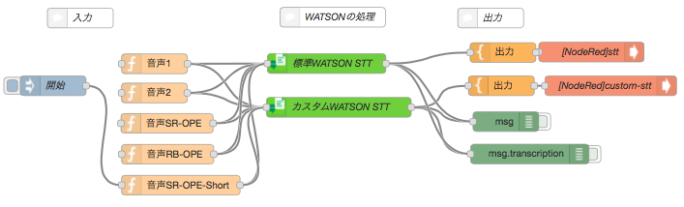
HTTP API Demo Application
Input
Translate
Output
Standard STT
Custom STT
List of Sample Voice Recording Files
Translate speech to text
Feed the transcript
to Freeboard dashboard.
https://github.com/kmomose/watson/blob/master/NodeRed-stt.json1

Slide 8
Sample Output (https://yournodered.net/freeboard)
Standard STT
Custom STT

Slide 9
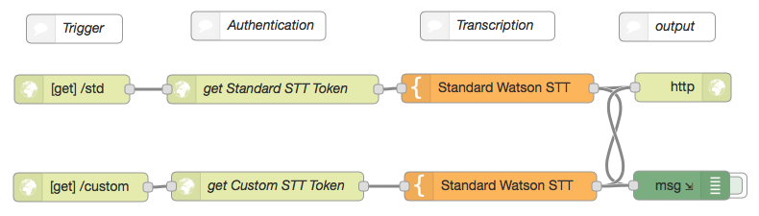
websocket API Demo Application
https://flows.nodered.org/flow/d43d0733b42ee0d42e7bba896d20d09b

Slide 10
Sample Output (https://yournodered.net/sst and https://yournodered.net/custom)
Standard STT
File input form
Custom STT
File input form

Slide 11
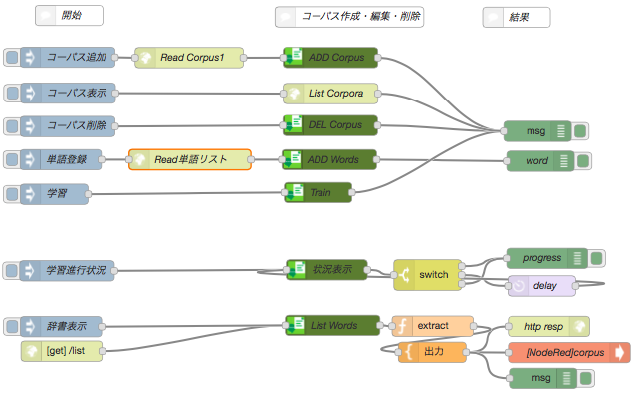
Corpora & Words Management
Trigger
Process Corpora&Words
Result
Read words file
Show Status

Slide 12
Sample Output (https://yournodered.net/freeboard)
Standard STT
Custom STT
Trained Vocabulary
Word sounds_like display_as

Slide 13
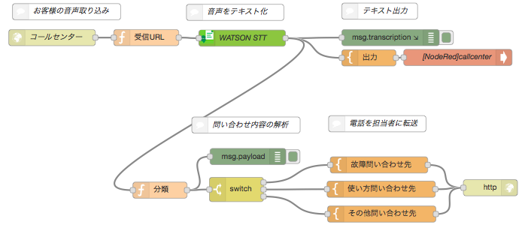
Callcenter Demo Application
Trigger
Translate
Output
Receive phone recording
from Twilio
Translate
Transfer Call to appropriate SME
Original idea comes from https://www.slideshare.net/masayafujita180/twilio-bluemix-hands-on

Slide 14
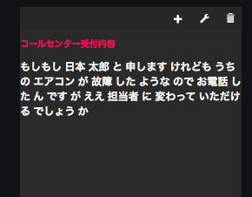
Sample Output
Search words intended to
machine failure
Technical Support
Operational Support
Sales and Others

Slide 15
Thank you

